Slide 1

SARDAR VALLABHBHAI NATIONAL INSTITUTE OF TECHNOLOGY
Digital Communication Lab
Exp. No. 5
PAM, PWM & PPM

Slide 2
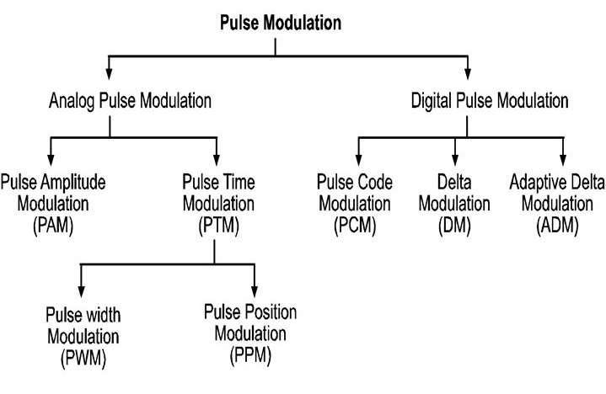
Pulse Modulation Technique

Slide 3
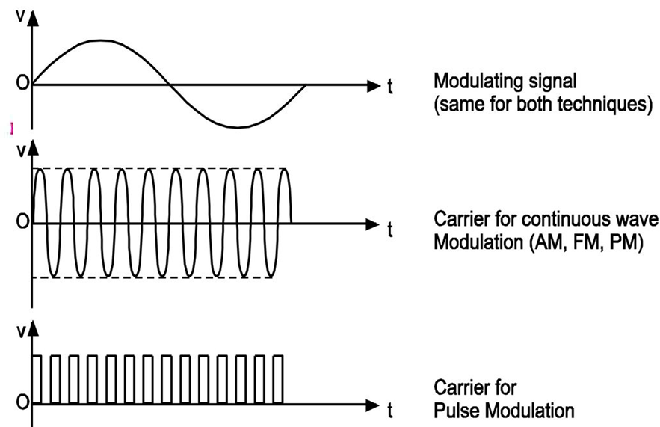
Carrier for continuous wave and pulse modulation

Slide 4
Need of Pulse Modulation
Comparing to continuous wave modulation (like AM, FM), the performance of all pulse modulation schemes except PAM in presence of noise is very good.
Due to better noise performance, it requires less power to cover large area of communication.
Due to better noise performance and requirement of less signal power, the pulse modulation is most preferred for the communication between space ships and earth.

Slide 5
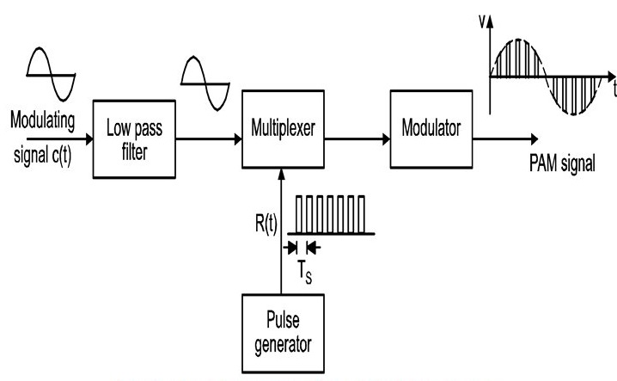
Pulse Amplitude Modulation (PAM)
Definition:
The amplitude of the pulsed carrier varies in accordance with the instantaneous value of modulating signal, is called PAM where width and position remains constant.

Slide 6
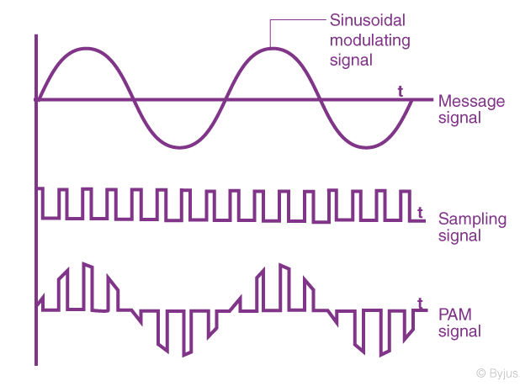
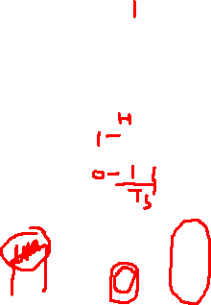
Waveforms of PAM

Slide 7
Advantages of PAM
It is easy to generate and demodulate PAM.
Disadvantages of PAM
Noise interference is high.
Too large bandwidth is required.
Transmitted power is not constant.
Application of PAM
Used in radio telemetry for remote monitoring and sensing.

Slide 8
Pulse Time Modulation (PWM)

Slide 9
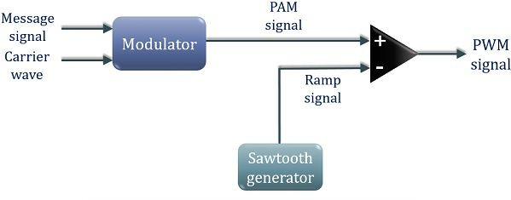

Pulse Width Modulation
Definition:
When the width of pulsed carrier varies in accordance with the instantaneous amplitude of modulating signal, is called PWM where amplitude and position remains constant.

Slide 10
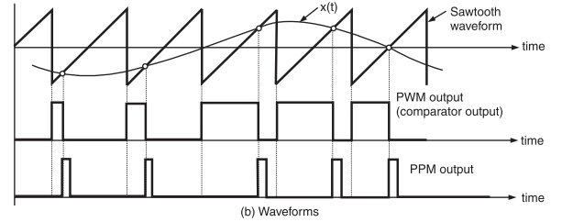

Waveforms for Pulse Width Modulation

Slide 11
.
Advantages of PWM
More immune to noise.
Synchronization between transmitter and receiver is not required.
Possible to separate out signal from noise.
Applications of PWM
PWM is used in special purpose communication systems mainly for military but is seldom used for commercial digital transmission system.

Slide 12
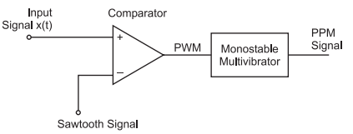
Pulse Position Modulation (PPM)
Definition
When position of pulse carrier varies in accordance with the instantaneous value of modulating signal is called PPM, where width and amplitude of carrier remains constant.

Slide 13
Waveforms of PPM

Slide 14
Advantages of PPM
Good noise immunity.
Requires constant transmitter power output.
Disadvantages of PPM
Requires synchronization between transmitter and receiver.
Large Bandwidth requirement.
Applications of PPM
optical communication system where there is no multipath interference.
PPM is useful for narrowband FM channel allocation
Military applications.

Slide 15
Comparison of PAM, PWM and PPM
Parameter | PAM | PWM | PPM
1. Variable parameter of pulsed carrier. | Amplitude | Width | Position
2. Bandwidth requirement | Low | High | High
3. Transmitted power | Varies with amplitude of pulses | Varies with variation in width | Remains constant
4. Noise immunity | Low | High | High
5. Information contained in | Amplitude variations | Width variations | Position variation
6. Output waveform

